Slide 1
Discover Malicious Websites using Data Mining Algorithms
By:
Pratibha Awasthi
Manish Mapakshi
Sai Gowtham Ande
Srinivas Gutta

Slide 2
Outline
The 2003 Phishing Attack (ebay & PayPal)
What’s a Phishing website?
Machine Learning Approach.
Our Take: Introduction to Data Set
Details of Data Sets
Approaches.
Method - I (exclusion of -1)
Method – II (inclusion of -1)

Slide 3
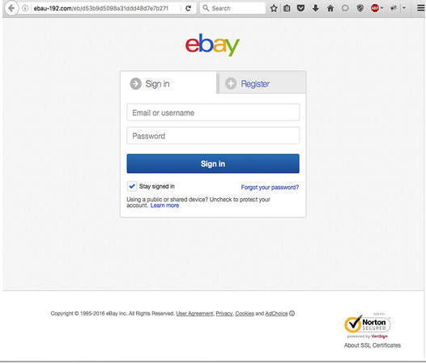
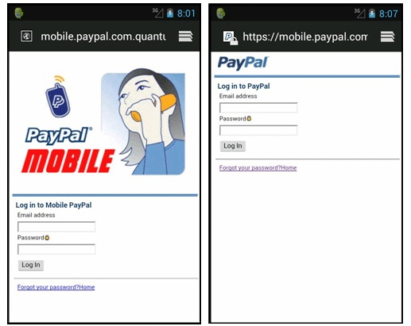
The 2003 Phishing Attack (ebay & PayPal)
Image source
Image source

Slide 4
What’s a Phishing website?
Phishing is an act of duplicity. The criminal sets us a website with a similar name and appearance to an official website
The purpose is to acquire sensitive information that can be used against the victim.
By 2004, phishing evolved into a profitable business and was officially recognized as a fully organized part of the black market¹.
According to a Gartner study, between 2004 and 2005, an estimated 1.2 million U.S¹.

Slide 5
Machine Learning Approach:
Different Machine Learning Algorithms help us to classify non-phishing websites from phishing ones.
Implementation of classification algorithm and techniques to extract the phishing data sets criteria to classify their legitimacy.
Website can be detected based on some important characteristics like URL and Domain Identity, and security etc.
According to the researchers’ experiments, the model reached 94% accuracy in detecting phishing websites².

Slide 6
Our Take: Introduction to Data Set
The Data set provides collection of both genuine and phishing website examples.
Each website is represented by the set of features which denote, whether website is legitimate or not.
The repository had two variants of Phishing Data set.
In both the variants, 0 labeled websites are legitimate & 1 labeled websites are Phishing.

Slide 7
Details of Data Sets
Six groups of attributes based on:
URL properties
Domain Properties
URL directory properties.
URL file properties.
URL parameter properties
URL resolving data & external
metrics.

Slide 8
Details of Data Sets(cont)
Dataset_full.csv
Total number of instances: 88,647
Number of 0s: 58,000
Number of 1s: 30,647
Total number of features: 111
Reason to choose: Provides sufficient data for training, realistic accuracy & maintains bias-variance tradeoff
Dataset_small.csv
Total number of instances: 58,645
Number of 0s: 27,998
Number of 1s: 30,647 Total
Number of features: 111
Reason to choose: More Balanced Classes

Slide 9
Approaches:
During the analysis the data set was found to consist ‘-1’
No description for ‘-1’ given.
Two schools of belief:
A considerable data involves -1. Removing such data will compromise the accuracy of the result, and hence the -1 should be considered.
The features mentioned in the data set do not make sense under negative values. For example, the length of the URL can never be negative. Hence, the negative values should be considered as missing data.
Generated two methodologies.

Slide 10
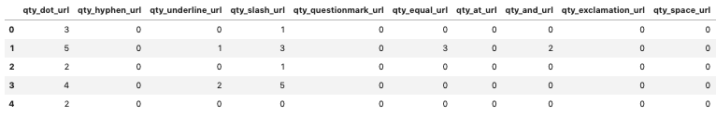
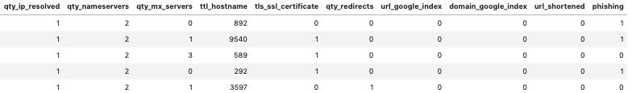
Method - II (inclusion of -1)
This approach uses large data set (Dataset_full.csv) while keeping the -1.
The purpose is to stick to the real-world scenario and predict realistic accuracy

Slide 11
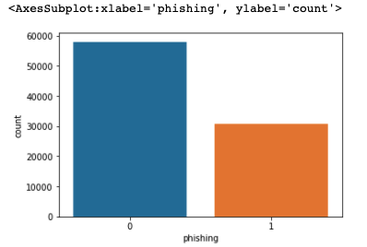
Method – II: Data load, Manipulation and EDA
Data Load & Manipulation:
The data is initially checked for NA values. However, no such null values were found.
Later, unique values of data have been checked and printed.
Exploratory Data Analysis:
The data is analyzed to find no of counts for ‘0’ and ‘1’ (58000 for 0s & 30647 for 1s).
The 0s and 1s are plotted

Slide 12
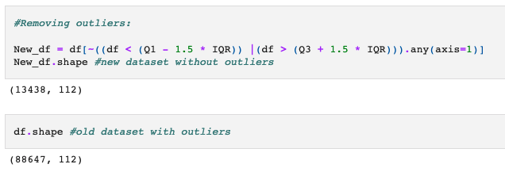
Method – II (cont.)
Outliers:
The outliers are detected using the z score. In this methodology, the threshold is kept to 3.
Using IQR, the outliers are removed, and a new dataset is generated.

Slide 13
Method – II: Modeling
The accuracy is retrieved using three different models. They are:
Decision Tree: The accuracy found through decision tree is 95.65%
Random Forest: The accuracy found through Random Forest is 97.52%
KNN: The accuracy found was 97.29%.
It is concluded that the Random forest detected the best accuracy.

